Slide 1

HR Employee Attrition Analysis

Slide 2
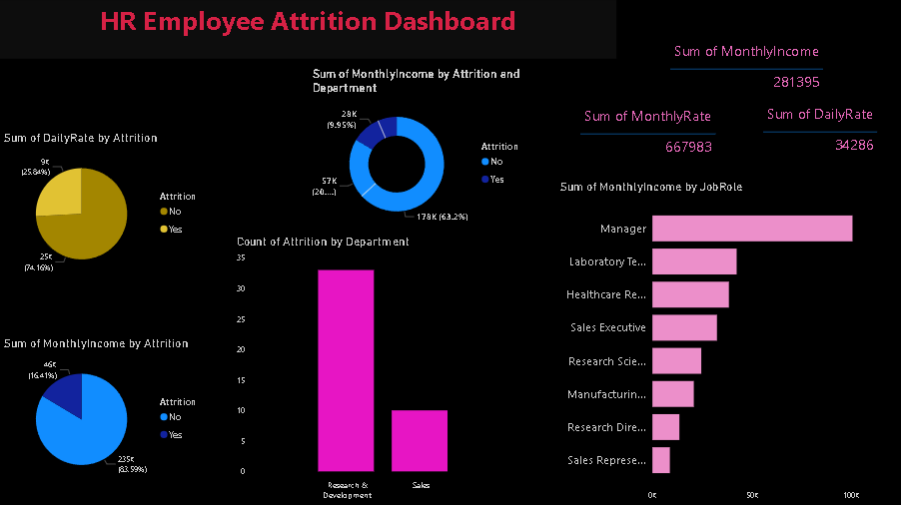
My Dashboard

Slide 3


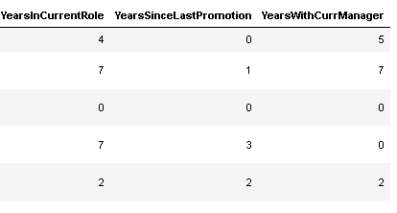
Top 5 values of HR Employee Attrition

Slide 4
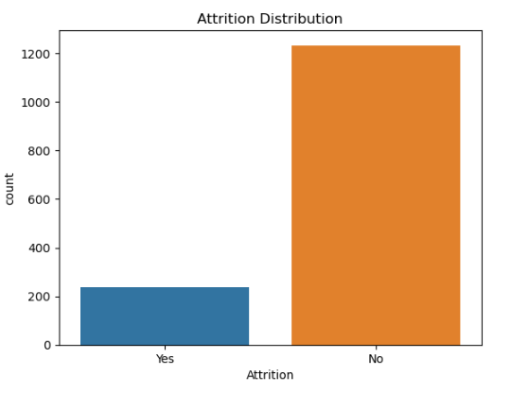
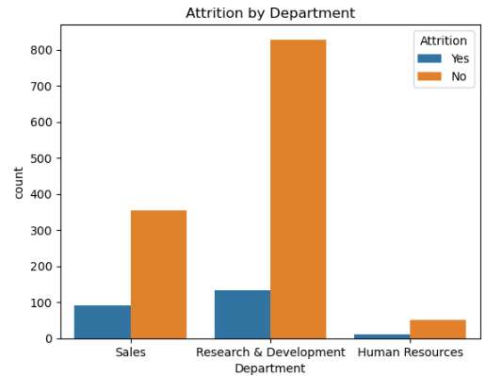
My Designs

Slide 5

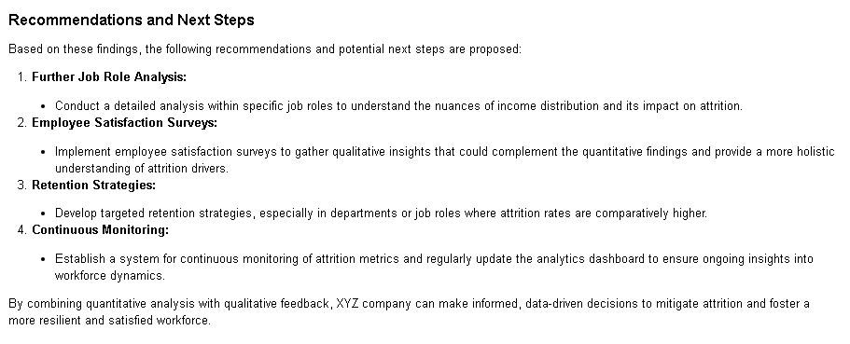
Conclusion

Slide 6
Thank You

